Slide 1


The Narrative
Budget
The Basics
…A Webinar
THE NARRATIVE BUDGET
The Basics…
Zoom presentation
WEDNESDAY, APRIL 26, 2023
7:00 PM
7:00 p.m.
Sponsored By MRD Finance Committee
For District Ministry Leaders, Church Finance Teams, Clergy, and Treasurers
Rev. Dr. Donna Taylor, Chair MRD Finance Committee
donnataylor@vaumc.org

Slide 2
The Narrative Budget
MRD Relaunch described A New Vision:
Focus on mission and ministry

Slide 3
The Narrative Budget
…focus on mission and ministry
As we follow this path…
It honors what we value and;
What we believe as the Mission Rivers District.

Slide 4
The Narrative Budget
…focus on mission and ministry
For District Ministry Leaders ONLY:
Old Method: Submit your budget request.
New Method: Submit your FY2024 budget request with your spending plan.

Slide 5
The Narrative Budget
…focus on mission and ministry
For District Ministry Leaders ONLY:
Example: District Music and Fine Arts Ministry
Budget Request: $1,600.00
FY 2024 Spending Plan:
$1,000.00 for Music Workshop Retreat (20 members & facilitator)
$500.00 to maintain instruments
$100.00 for CCLI License (Christian Copyright Lic.)

Slide 6
The Narrative Budget
…focus on mission and ministry
For Local Church Finance Teams:
Use the Narrative Budget to tell your ministry’s story in the local church.

Slide 7
Important tip:
The Expanded Ministry Budget line items are grouped in categories.

Slide 8
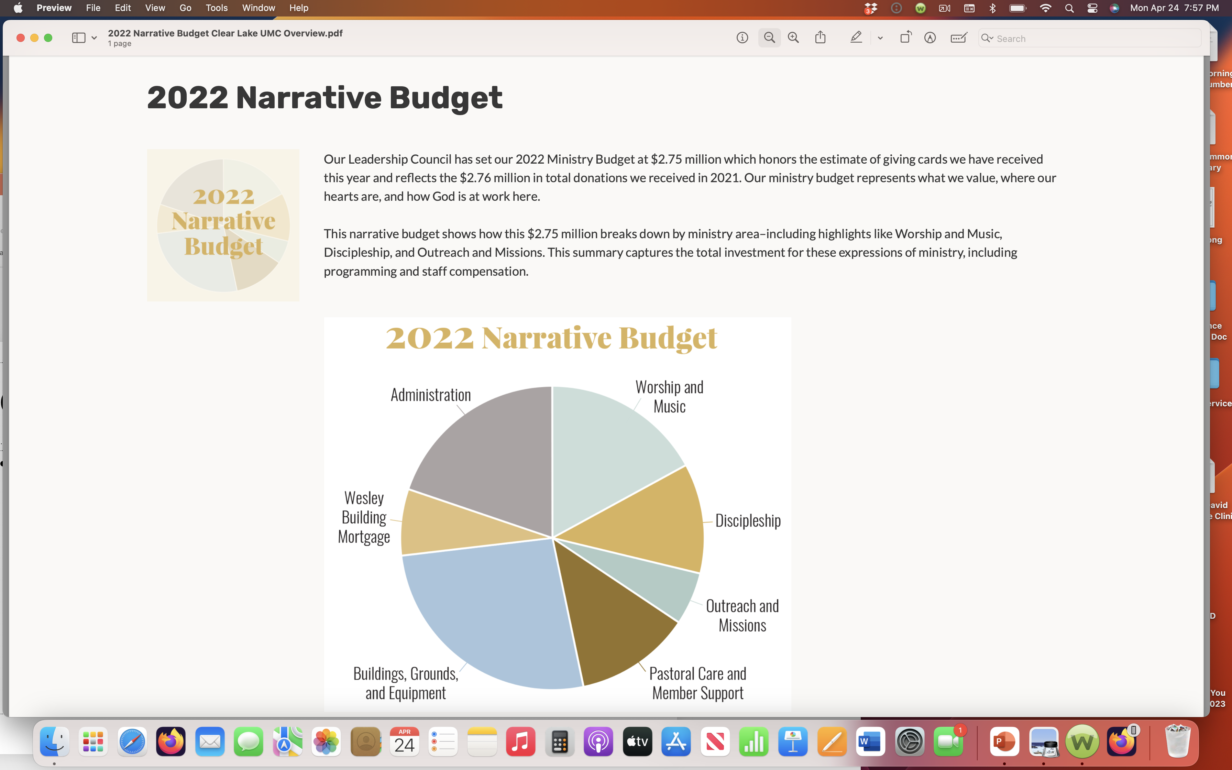

Slide 9
The Narrative Budget
…focus on mission and ministry
FY 2024 District Budget Request:
  Submit requests before Holy Conferencing (Roanoke, VA in June).
  MRD Finance Committee will be preparing the FY 2024 budget this Fall.
  Budgets will not be approved unless a spending plan is included.
FY 2024 Church Narrative Budget Plan:
  Engage the Finance Team to work together
  Plan for Fall of 2023 to tell the story of mission and ministry at your church
  Plan to share your FY2024 Budget at your church council meeting (Fall 2023)

Slide 10
The Narrative Budget: Resources/Links
https://www.churchleadership.com/leading-ideas/a-simple-step-by-step-process-for-creating-a-narrative-budget/
This is a pretty neat end result of such work and might be a good inspiration on what the district sees.
https://www.resourceumc.org/-/media/umc-media/2020/01/13/22/34/final-version---2020-narrative-budget.ashx?la=en&hash=17B2B8B89F61DAB18908FB6C04FB1A54CD8143C3
Here is more on how it was made: https://www.resourceumc.org/en/content/leader-spotlight-jamie-clark
Here is another sample: https://www.resourceumc.org/-/media/umc-media/2019/10/14/19/35/2015-hixsontn-narrative-budget-brochure.ashx?la=ko&hash=405E2A8DD232E2DAA9D959136F06421F995DAFBA
https://centerforfaithandgiving.org/2016/01/building-a-narrative-budget/
Clear Lake UMC: https://www.clearlakemethodist.org/content.cfm?page_content=announcement_include.cfm&announcement_id=4506

Slide 11
The Narrative Budget
…focus on mission and ministry
Recorded Zoom presentation, resources, and links will be on the MRD website.
Questions? Next Steps?
Email: Rev. Dr. Donna Taylor, Chair MRD Finance Committee at donnataylor@vaumc.org

